Slide 1
Sprint 4 Demo
1095-B TAX FORM
Tuesday, March 22nd, 2022

Slide 2
















Get to know the team
Rolling off project on April 1
Core team
Executive team
PRODUCT
ENGINEERING
Ashley Castillo Washington DC Product Manager Lead
Munish Sikka
Washington DC
Product Manager Lead (Incoming)
Jordan White Dallas, TX Product Manager
Tami Corson
North Carolina
Scrum Master
Nadya Primak Washington DC Engineer
Teagan Stephenson Ft. Lauderdale, FL Backend Engineer
Jeff Scheire
MO Studio
Marcy Jacobs
McKinsey
Kevin London Frog
DESIGN
Kit Casey Boston, MA Design Director
Carl Dickerson Atlanta, GA Content Strategist and Plain Language Content Creator
Grace Hong New Jersey Experience
Designer
James Lewis Austin, TX Accessibility and
UX Research Lead
Will Reynolds SERVE
Ben Morris
Pluribus
Travis Hoffmann
MO Studio
03-22 Sprint 4 Demo
Introduction

Slide 3



At the end of each sprint on Tuesdays, the team will run sprint reviews to showcase the sprint’s work for approval. The purpose of this meeting is:
WELCOME TO THE SPRINT 4 DEMO
1
To demo the accomplishments or functionality that was built over the past sprint
2
To get feedback and insights early and often
3
To create transparency for anyone interested on the product and progress
03-22 Sprint 4 Demo
Introduction

Slide 4
Roadmap overview
We are here
PHASE
CY 2021
CY 2022
SPRINT
0
1
2
3
4
5
6
7
8
9
10
11
12
13
14
15
16
17
18
19
20
21
22
23
24
25
MONTH
Sep
Oct
Nov
Dec
Jan
Feb
Mar
Apr
May
Jun
Jul
Aug
FOCUS
DHM - Health Apartment
1095-B Form
Community Care, After Visit Summary
03-22 Sprint 4 Demo
Introduction

Slide 5
1095-B Overview
SPRINT 4 DEMO
03-22 Sprint 4 Demo

Slide 6
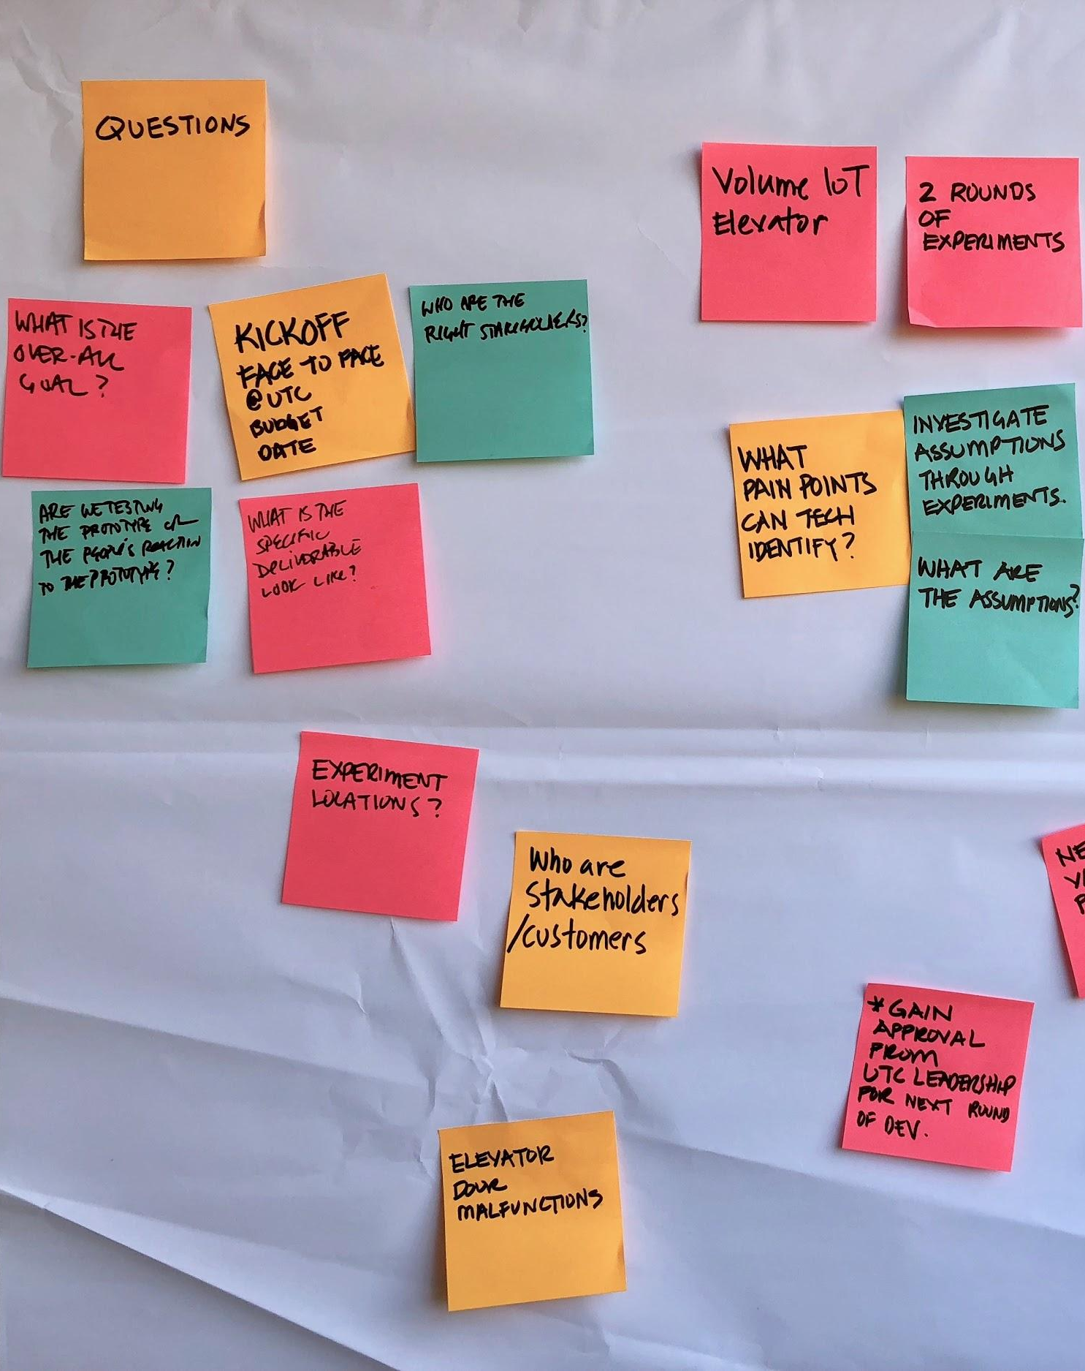
Project objectives
OVERVIEW
Digitize 1095-B form on VA.gov so Veterans can easily access the form and download the form for their records.
Goal: April 1st MVP launch
03-22 Sprint 4 Demo
Overview

Slide 7




1095-B Project Workplan for Sprint 0 to 5
Owned by design team
Owned by product/ engineering team
Release
WE ARE HERE
SPRINT 0
SPRINT 1
SPRINT 2
SPRINT 3
SPRINT 4
SPRINT 5
Week 1: 01/20 – 01/26
Week 2: 01/26–02/02
Week 3: 02/02 – 02/09
Week 4: 02/09 – 02/16
Week 5: 02/16 – 02/23
Week 6: 02/23 – 03/02
Week 7: 03/02- 03/09
Week 8: 03/09 – 03/16
Week 9: 03/16 – 03/23
Week 10: 03/23 – 03/30
Product & Delivery
Build backlog
Identify Change Management or Communications Plan
Handover plan - Prepare for launch
PIV Onboarding
Prioritized backlog
Immersion & onboarding
Legal Review
User Experience & Design
Immersion & onboarding
Testing prep
Testing prep & recruiting
Voice of Veteran
Voice of Veteran
PIV Onboarding
Wireframes & Design
Design iterations
User flows
Engineering & Development
Create tech discovery plan
Data discovery
POC for data flow
UAT with Call Center
Immersion & onboarding
Define data flows - Systems mapping
Build solution (form UI, data connections, storage, etc.)
Test & Refine
Collaboration Cycle
Kickoff
Midpoint Review
Staging Review
Analytics Review
Research Plan Review
Design Intent
Research Plan Review #2 (wireframes)
Content & IA Review
Privacy & Security review
Contact Center Review
*Does not show post-MVP Validate phase meetings in Collaboration Cycle, such as Full Accessibility Audit and Post-Launch Check In; Contact Center Review adjusted to 3 weeks before launch as approved by Jason Woodman
MVP Launch Date Dependent on Legal Review

Slide 8
Sprint 4
SPRINT 4 DEMO
03-22 Sprint 4 Demo

Slide 9
Agenda
Sprint Goal: For sprint 4 we focused on building out building out the PDF generation end to end
1
DESIGN
Designed error states
Presented research in VA Designers forum
Created product guides and video for Contact Center Review and HEC
Drafted communications that would go out through VA Notify
Coordinated with Sitewide Content on front end redesign
2
TECH
Built end to end flow to download a PDF
3
PRODUCT
Investigated how to make our PDF accessible
Coordinate remaining collaboration cycle reviews
Investigate with Profiles team and HEC to understand how opt in process may be built
 | We welcome all feedback! Feedback will be collectively reviewed and prioritized appropriately based on where it stacks against other stories in the backlog as well as technical feasibility.
03-22 Sprint 4 Demo
Agenda

Slide 10
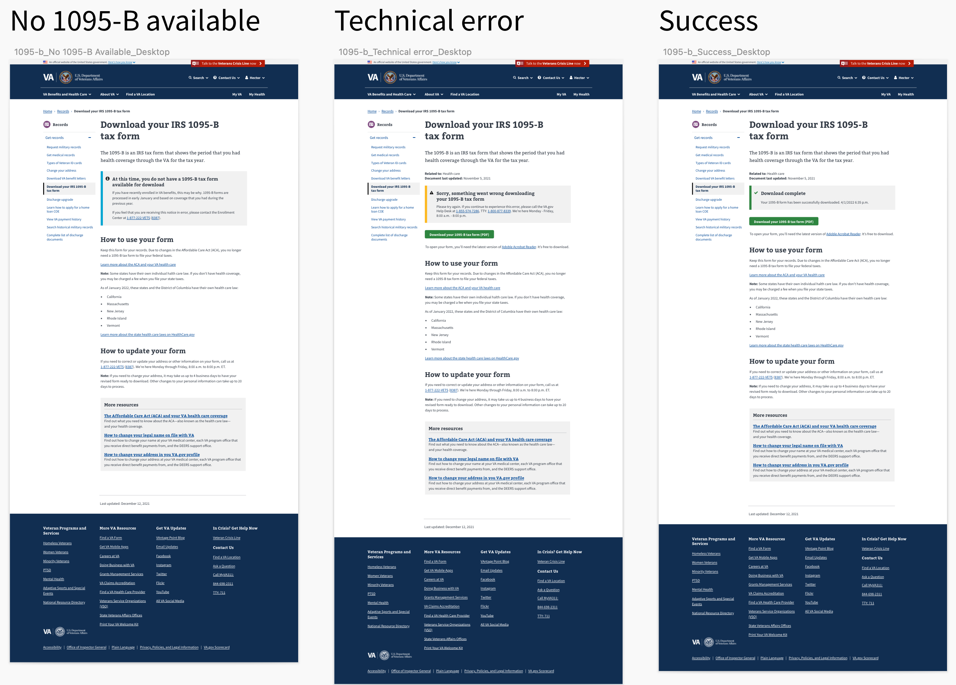
1
DESIGN
We designed for error states to help the Veteran understand if something goes wrong with their download
User Story: Draft designs for error state
No 1095-B available, technical error, and success links
03-22 Sprint 4 Demo
Design
10

Slide 11
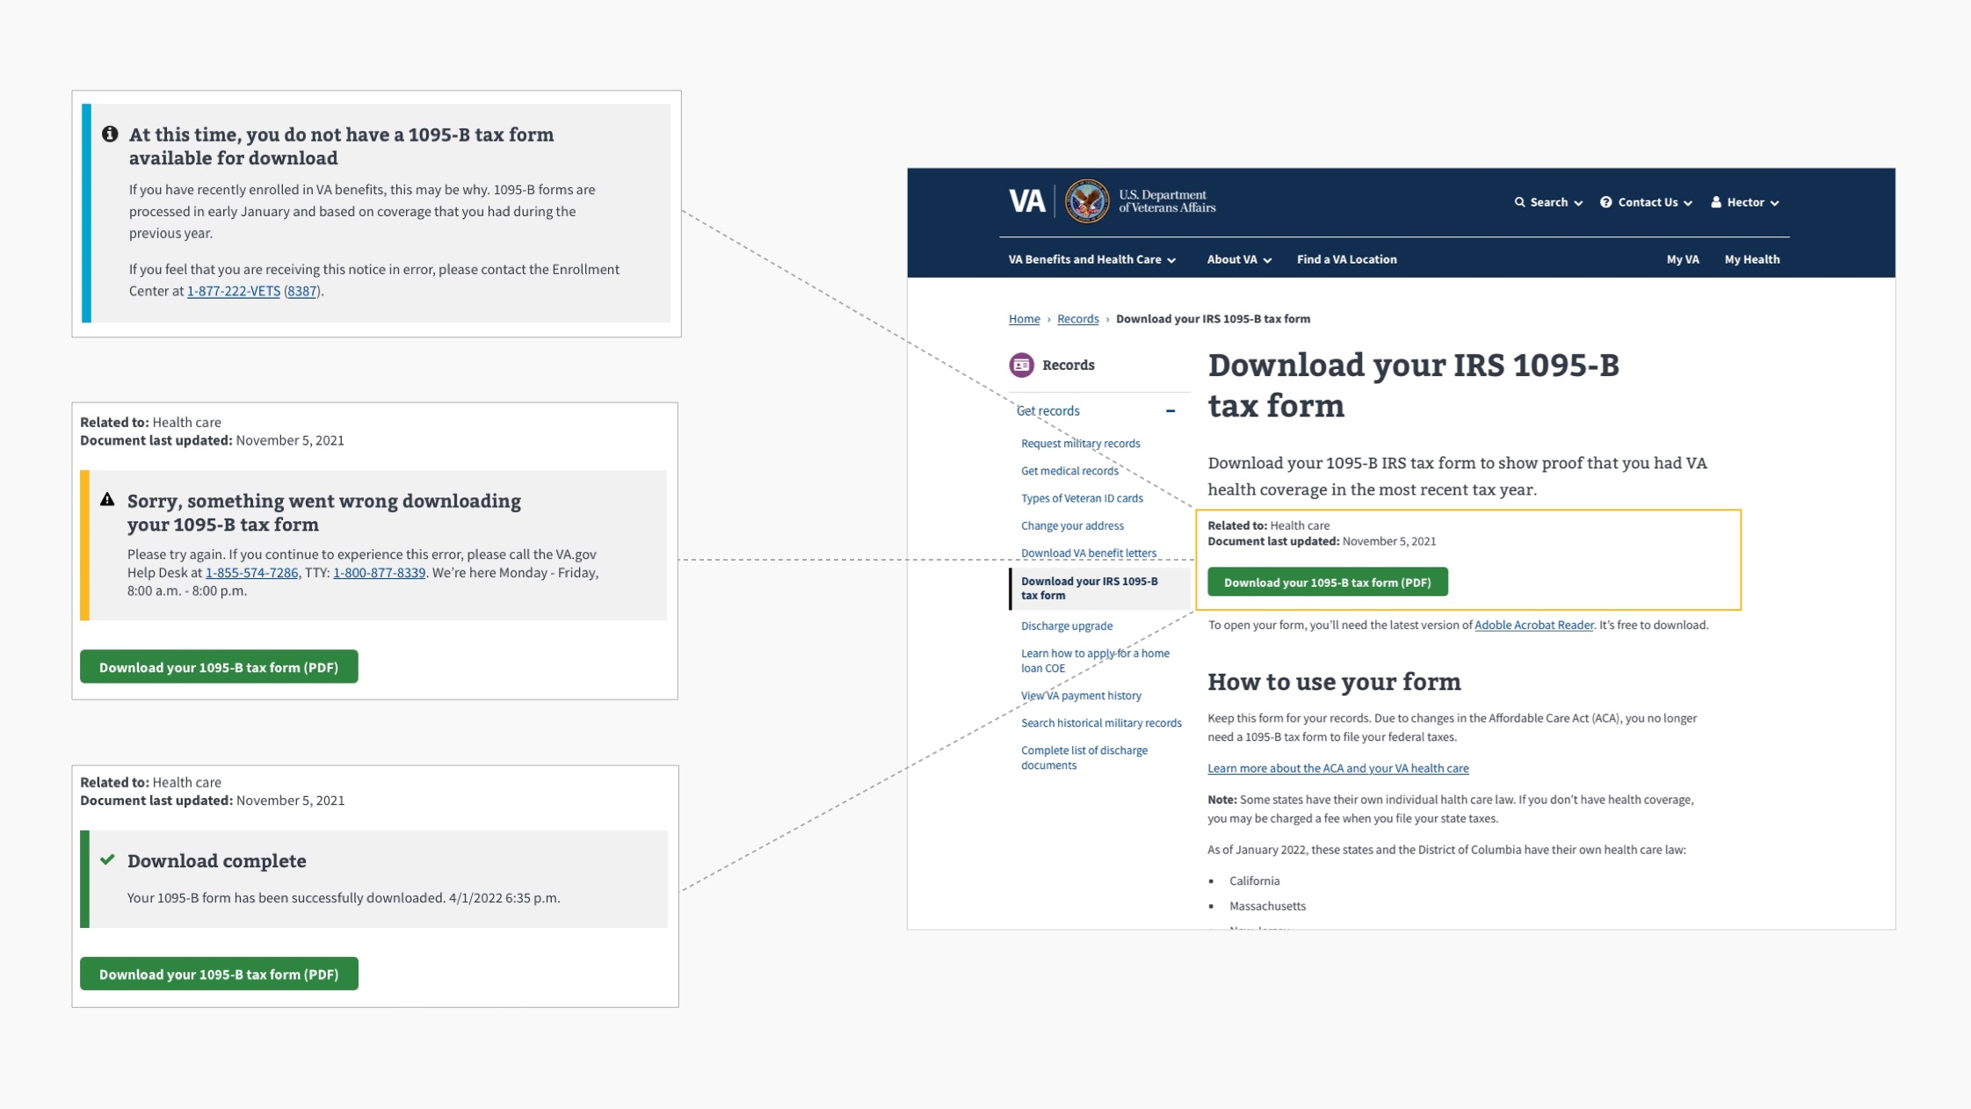
No 1095-B available
Technical issue
Success state
No 1095-B available, technical error, and success links
03-22 Sprint 4 Demo
Design
11

Slide 12

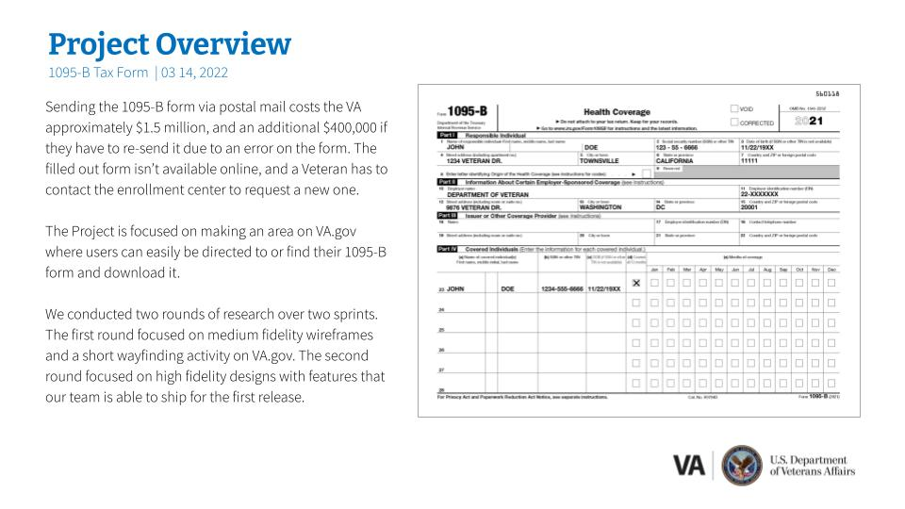
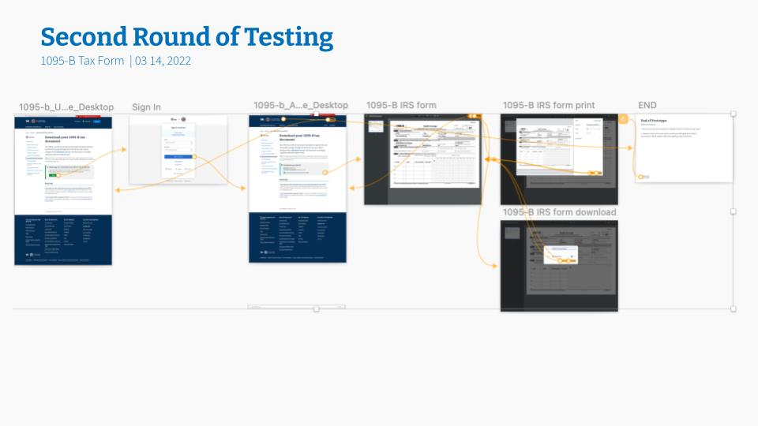
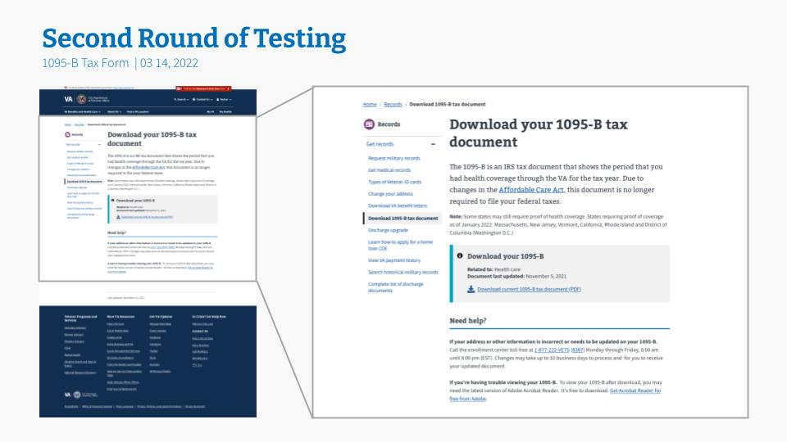
1
DESIGN
We presented our research findings in the weekly VA Design meeting to showcase our work
User Story: Presented research finding to VA Design team
Presented to the VA Platform Weekly Design Sync on the two rounds of the 1095-B user testing
Shared a copy of the prototype with the VA design community
Presentation Link
03-22 Sprint 4 Demo
Design
12

Slide 13
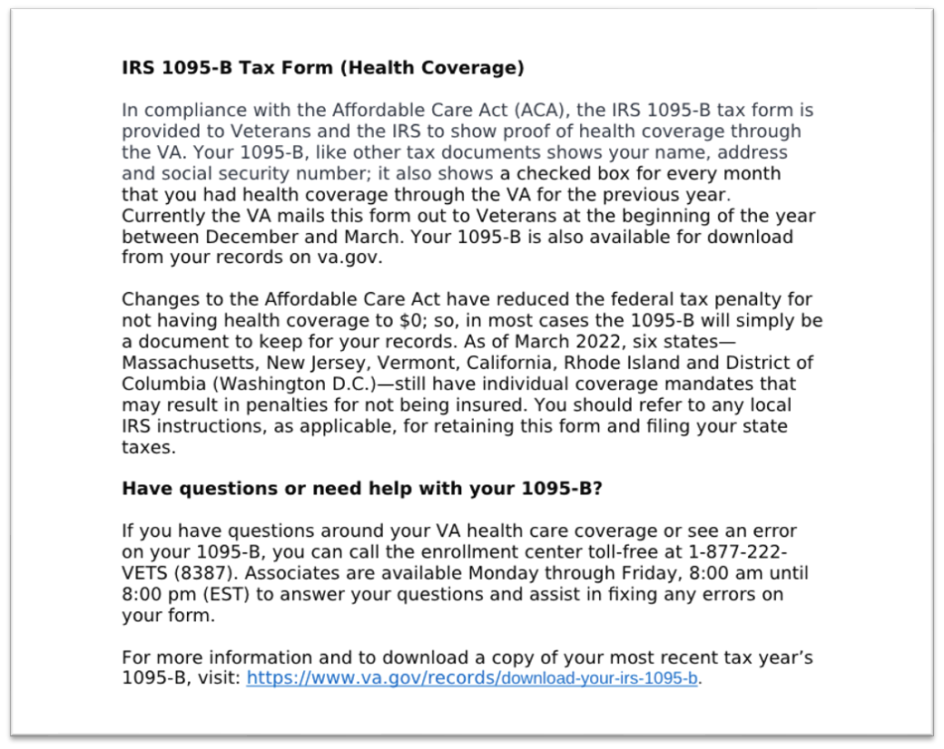
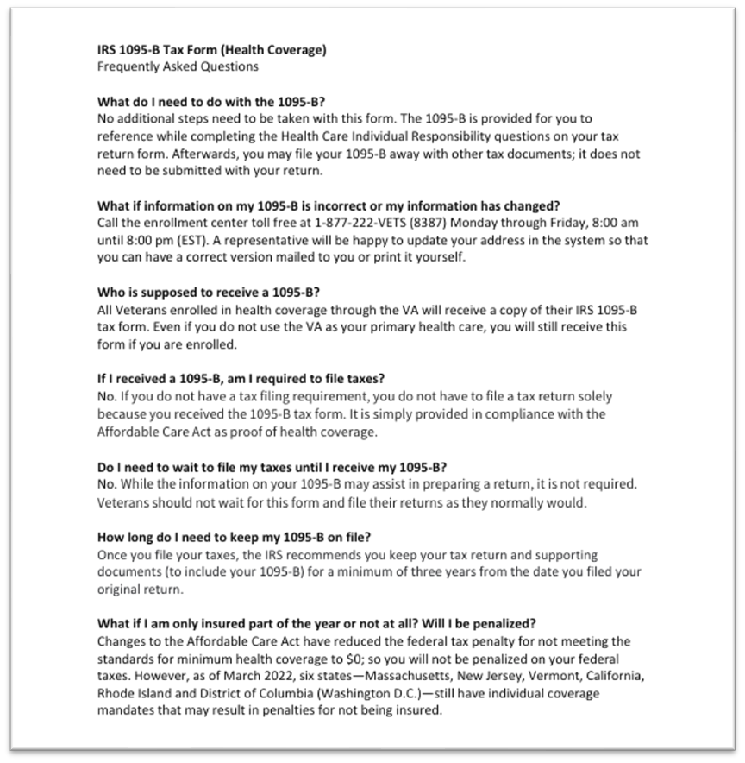

1
DESIGN
We created training materials to enable the VA to help Veterans use our product
User Story: Draft scripts for health enrollment centers (HEC’s) call center (based on Tarsha’s examples)
User Story: Create product video for contact center review
User Story: Update product guide based on initial contact center review feedback
User Story: Update product guide and cover letter content to reflect feedback from midpoint review
Training guide, FAQ’s, fact sheet and initial product video
03-22 Sprint 4 Demo
Design
13

Slide 14
1
DESIGN
We drafted future communications that would be sent to Veterans using the VA Notify platform (1/3)
User Story: Research into VA Notify and how 1095-B might use VA Notify
User Story: Draft Veteran notification – email
User Story: Draft Veteran notification – text message
Initial Announcement: Email
From: U.S. Department of Veteran Affairs Subject: Your IRS 1095-B tax form is now available online
Dear [First_Name],
In an effort to reduce paper and provide more convenient options for Veterans to access documents, we have now made the IRS 1095-B tax form (proof of health coverage) available online for download from your records on Va.gov. Visit https://www.va.gov/records/download-your-irs-1095-b to download and/or print a copy of this form.
Thank you, VA.gov
Initial Announcement: SMS
U.S. Department of Veteran Affairs: Now you can get your IRS 1095-B tax form (proof of health coverage) online. To download, visit: https://www.va.gov/records/download-your-irs-1095-b.
Meeting notes , email and text templates
03-22 Sprint 4 Demo
Design
14

Slide 15
1
DESIGN
We drafted future communications that would be sent to Veterans using the VA Notify platform (2/3)
Automated Notification: Email
From: U.S. Department of Veteran Affairs Subject: Your 2022 1095-B tax form is available for download
Dear [First_Name],
Your 2022 IRS 1095-B tax form (proof of health coverage) is now available for download. If you would like a copy for your records, please visit: https://www.va.gov/records/download-your-irs-1095-b.
Thank you, VA.gov
Automated Notification: SMS
U.S. Department of Veteran Affairs: Your [year] IRS 1095-B tax form (proof of health coverage) is now ready for download. Please visit: https://www.va.gov/records/download-your-irs-1095-b.
03-22 Sprint 4 Demo
Design
15

Slide 16
1
DESIGN
We drafted future communications that would be sent to Veterans using the VA Notify platform (3/3)
Form Updated Notification: Email
From: U.S. Department of Veteran Affairs Subject: Updates to your 1095-B have been processed
Dear [First_Name],
Thank you for contacting us. Requested changes to your 2022 IRS 1095-B tax form (proof of health coverage) have been updated in our system. To download and/or print a copy of the revised form, please visit: https://www.va.gov/records/download-your-irs-1095-b.
If you have not authorized this request or have any questions, please contact the Enrollment Center at 1-877-222-VETS (8387).
Thank you, VA.gov
Form Updated Notification: SMS
U.S. Department of Veteran Affairs: Changes to your [year] IRS 1095-B tax form have been processed. To download a copy, visit: https://www.va.gov/records/download-your-irs-1095-b. If you didn’t make this request, please call us at 1-877-222- 8387.
03-22 Sprint 4 Demo
Design
16

Slide 17
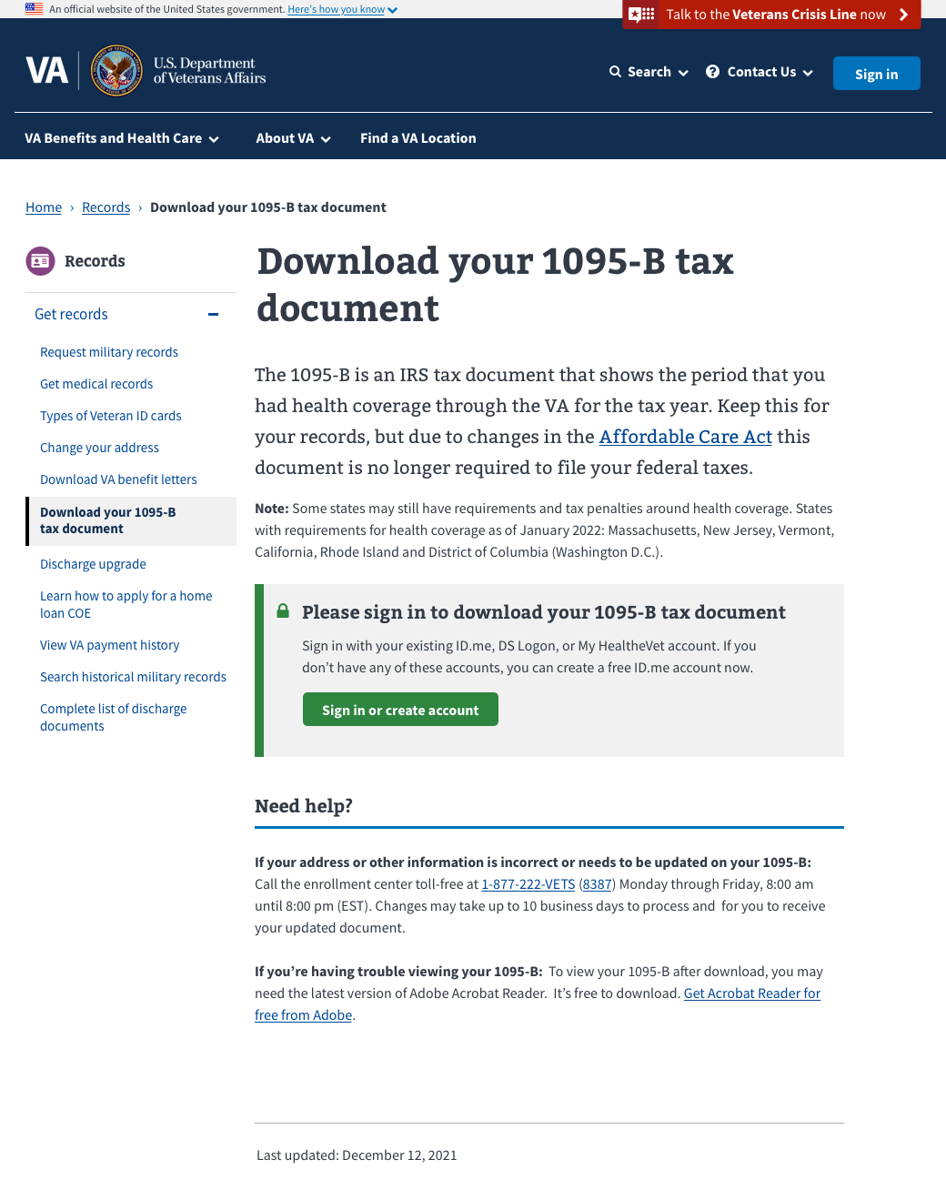
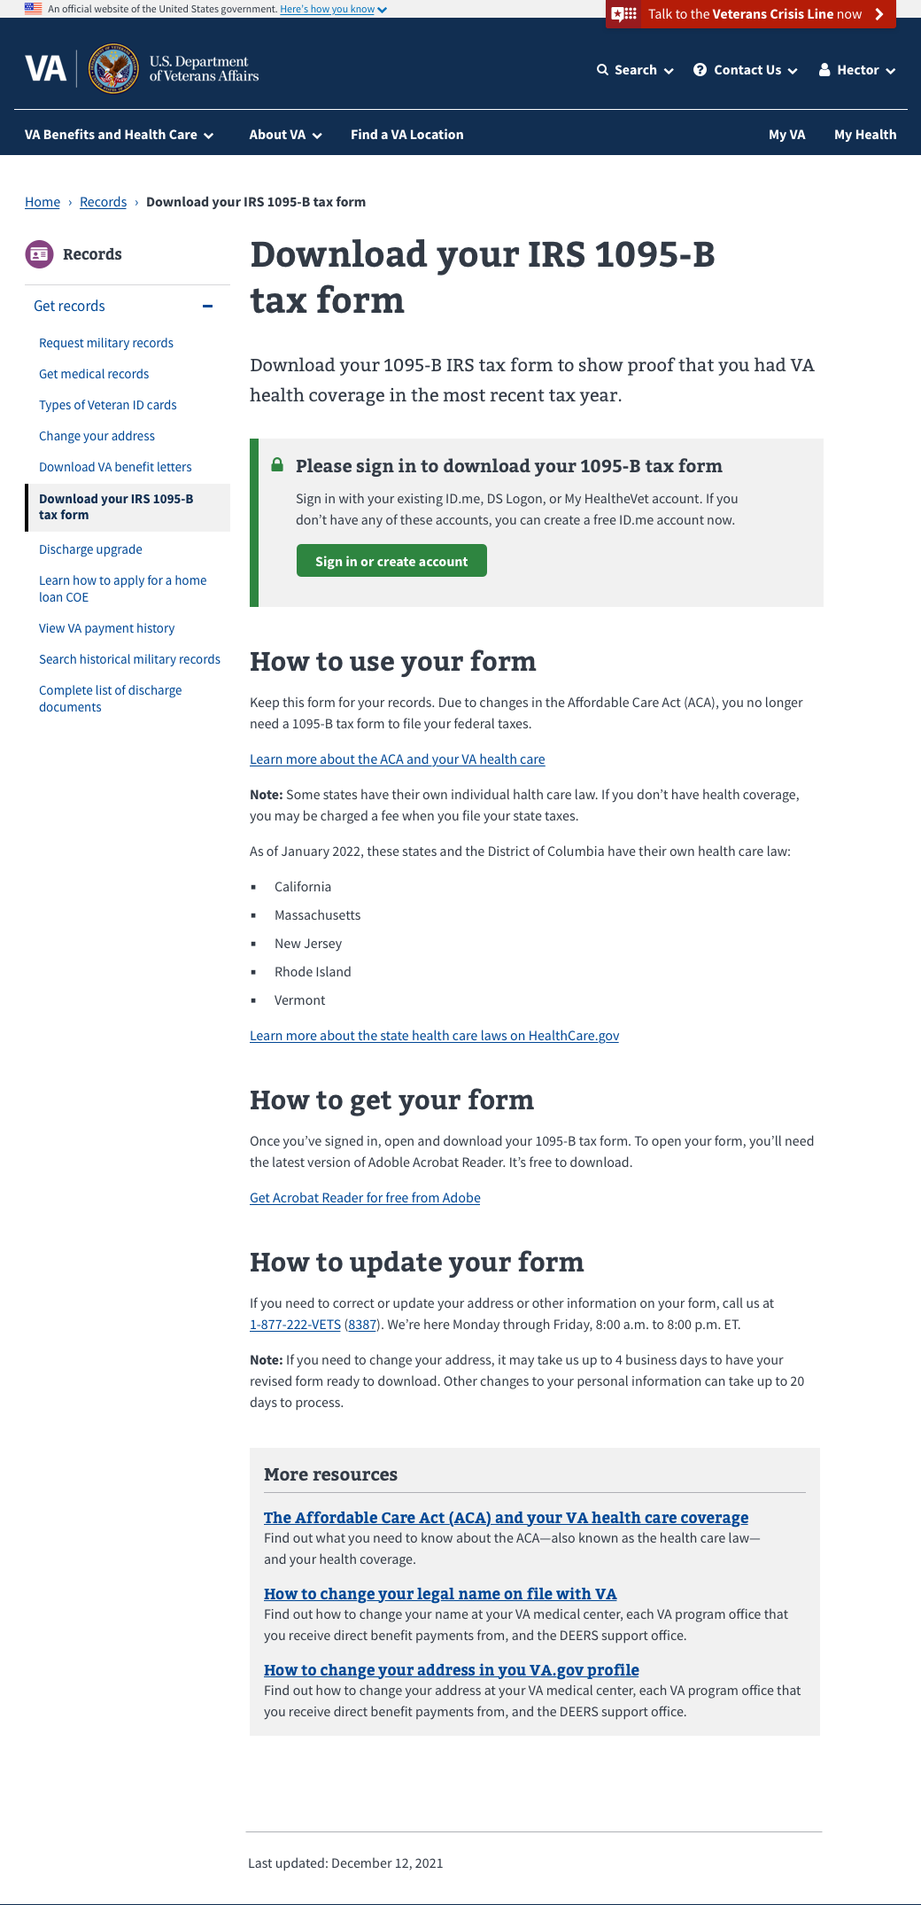
From
To
1
DESIGN
We also coordinated with the Sitewide Content team on their proposed changes to our front end
User Story: Iterate designs to reflect feedback from sitewide content
Limitations: Design system components in Drupal
Goal for authenticated experience: Continuity for Veterans between unauthenticated and authenticated views
Future needs: Getting the right content folks involved at the right time—and more integrated with collaboration cycle
Clearer documentation for content patterns and component availability between authenticated/ unauthenticated
Open question: Need clarity on who reviews content for authenticated experience
Presentation Link
03-22 Sprint 4 Demo
Design
17

Slide 20
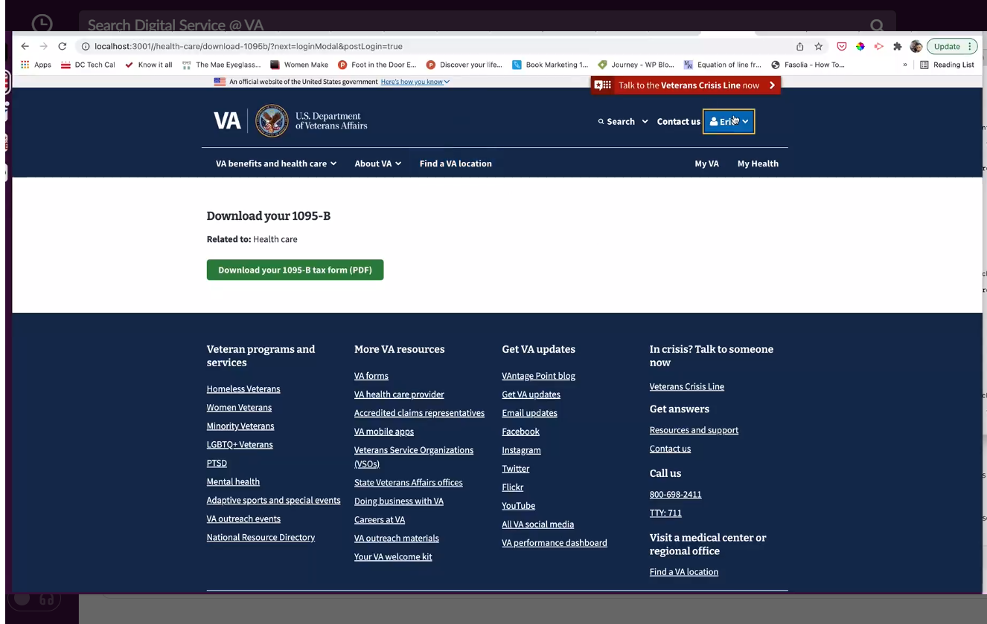
2
TECH
We built our product end to end
User Story: Make POC Script Production ready
User Story: Get widget into production on for front end
User Story: Finish controller (authentication)
User Story: Test authentication with front end and back end
User Story: Get PDF generator working to send back PDF
User Story: Make API call on front end (integrate with back end)
User Story: Back end testing
User Story: Update content on widget to match final designs
User Story: As a Veteran, I want to download mu form so that my tax records are complete
User Story: As a Veteran, I want to easily find the form through Google so that I can find it through my normal methods
*Note – Sitewide Content now owns static front end content, thus not shown in our video
Product video, front end, S-3, and back end branch
03-22 Sprint 4 Demo
Tech
20

Slide 21
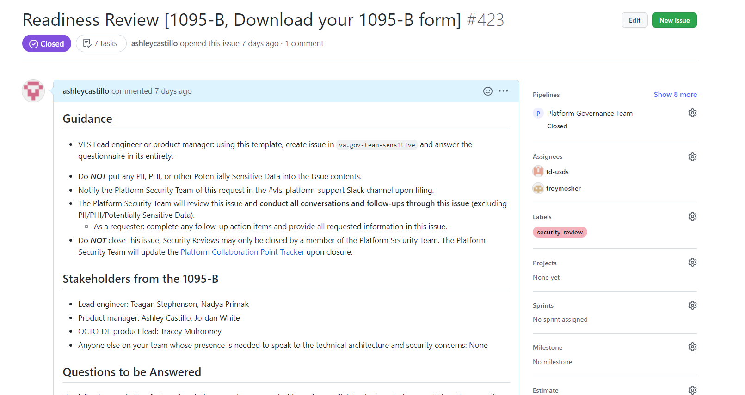
We prepared for Collaboration Cycle milestones and completed Security & Privacy Review
3
PRODUCT
User Story: Update technical diagram for security review
User Story: Draft release plan for security review
User Story: Privacy and Threshold Analysis (PTA) request 1095-B team
User Story: Privacy and Security review
Completed Collaboration Cycle milestones:
Design Intent (Sprint 2)
Research Plan Review (Sprint 2 and 3)
Midpoint Review (Sprint 3)
Content & IA Review (Sprint 3)
ATO Compliance – Not needed
Privacy and Security Review (Sprint 4)
Remaining Collaboration Cycle milestones:
Contact Center Review (Sprint 4, needs to be redone in Sprint 5)
Staging Review
Analytics Request
Technical diagram, release plan and GitHub ticket
03-22 Sprint 4 Demo
Product
21

Slide 22
3
PRODUCT
We assessed the PDF for accessibility
User Story: 1095-B Team staging review accessibility checklist
Assessment Results
Attempts to address
Path forward
Original PDF from IRS passed 23/26 accessibility tests run on Adobe Pro. Security issues make it so it can’t be fixed using Adobe tools
Failures:
Language
Field Descriptions
Title
Populated PDF, after using Adobe Accessibility tools, failed one test:
Tagged Content
We tried using the populated PDF First Name that only failed one test as the new base PDF, but we ran into new accessibility errors.
Pluribus PDF expert tried rebuilding the PDF, but Adobe’s OCR does not recognize the fields since the original form was built in an older version of Adobe
Move forward into staging to utilize VA accessibility team to test through other tools we do not have access to
Look into rebuilding PDF entirely from scratch in newer version of Adobe
Ask IRS for the unsigned XC file, so we can fix the settings, or they can fix the settings before passing back to us
Color contrast test, PDF Accessibility

Slide 23
We explored and facilitated discussions with HEC and VA Profiles teams for opt-in
3
PRODUCT
User Story: Investigate with profiles team and HEC to understand opt-in process
Met with VA Profiles Team and HEC Tech Team together:
Aligned together that opt-in build would be owned by VA Profiles and HEC. Opt-in would be built in a way to allow Veteran to set opt-in on VA.gov, and allow Call Center staff to set it on their behalf if Veteran calls in
VA profile would hold the opt in authoritatively in communications permissions for the Veteran. If enrollment needs a copy of it for any reason, VA profile would provide a copy
Enrollment system will pull opt in from profile to pass on to print vendor and exclude from paper mailing
VA Profiles and HEC agreed address updates have bidirectional synchronization — so if someone updates via enrollment system, Profile gets that information, and if someone updates address on Profile, it syncs with Enrollment System.
Next Steps
1095-B team to submit intake form to VA Profile and HEC to request the opt-in work from both teams
VA Profile Team and HEC team to prioritize the work and build it
1095-B team to follow up with VA Profile and HEC, understand timeline once work is prioritized, and continue to oversee until opt in build complete
Meeting notes
03-22 Sprint 4 Demo
Product
23

Slide 24
Sprint 4 Deliverables (1 of 3)
EPIC | STORY | ESTIMATE | ASSIGNED | OUTPUT | REVIEWED WITH VA-PO | SPRINT TEAM GOAL COMPLETED?
Design | #38270 Update product guide and cover letter content to reflect feedback from mid-point review | 2 | Carl | Product guide Cover letter | 03/15/22 | ✓
Design | #37014 Create product video for contact center review | 2 | Carl | Product video | 03/15/22 | ✓
Design | #38033 Draft scripts for Health Enrollment Center’s call center (based on Tarsha’s example) | 3 | Carl | Training guide FAQ’s Fact sheet | 03/15/22 | ✓
Design | #38032 Update product guide based on initial contact center review feedback | 2 | Carl | Product guide Contact center review ticket | 03/15/22 | ✓
Design | #37715 Draft designs for error state | 3 | Grace | Demo deck p. 10-11 | 3/15/22 | ✓
Design | #38703 Iterate designs to reflect feedback from sitewide content | 2 | Grace | Mural | 03/18/22 | ✓
Design | #38300 Present research finding to VA design team | 3 | James | VA Design presentation | N/A | ✓
Design | #38705 Draft Veteran notification - email templates | 3 | Carl | Email templates in GitHub | 3/15/22 | ✓
Design | #38704 Draft Veteran notification - text messaging | 1 | Carl | Text templates in GitHub | 3/15/22 | ✓
03-22 Sprint 4 Demo
Sprint 4 Deliverables

Slide 25
Sprint 4 Deliverables (2 of 3)
EPIC | STORY | ESTIMATE | ASSIGNED | OUTPUT | REVIEWED WITH VA-PO | SPRINT TEAM GOAL COMPLETED?
Tech | #38173 Update content on widget to match final designs | 3 | Nadya | Video GitHub branch | 03/22/22 | ✓
Tech | #38087 Get widgets into production for front end | 3 | Nadya /Ashley | Landing page by sitewide | 03/22/22 | ✓
Tech | #38094 Get PDF generator working to send back PDF | 3 | Nadya | Video GitHub branch – front end | 03/22/22 | ✓
Tech | #38095 Make API call on front end (integrate with back end) | 3 | Nadya | Video GitHub branch – front end | 03/22/22 | ✓
Tech | #36448 As a Veteran, I want to easily find the form through Google so that I can find it through my normal methods | 1 | Nadya | Video GitHub branch – front end | 03/22/22 | ✓
Tech | #37029 Make POC script production ready | 8 | Teagan | Video GitHub branch – S3 GitHub branch – back end | 03/22/22 | ✓
Tech | #35824 As a Veteran, I want to download my form so that my tax records are complete | 2 | Nadya | Video GitHub branch – front end | 03/22/22 | ✓
Tech | #38089 Finish controller (authentication) | 3 | Teagan | Video GitHub branch – S3 GitHub branch – back end | 03/22/22 | ✓
Tech | #38090 Test authentication with front end and back end | 3 | Teagan | Video GitHub branch – S3 GitHub branch – back end | 03/22/22 | ✓
Tech | #38096 Back end testing | 5 | Teagan | Video GitHub branch – S3 GitHub branch – back end | 03/22/22 | ✓
03-22 Sprint 4 Demo
Sprint 4 Deliverables

Slide 26
Sprint 4 Deliverables (3 of 3)
EPIC | STORY | ESTIMATE | ASSIGNED | OUTPUT | REVIEWED WITH VA-PO | SPRINT TEAM GOAL COMPLETED?
PM | #37713 Update technical diagram for Security Review | 3 | Ashley | Technical diagram GitHub ticket | 03/10/22 | ✓
PM | #37714 Draft release plan for Security Review | 3 | Jordan/Ashley | Release plan GitHub ticket | 03/10/22 | ✓
PM | #38168 Privacy Threshold Analysis (PTA) request 1095-B Team | 3 | Jordan/Ashley | Ticket link | 03/10/22 | ✓
PM | #38387 1095-B team staging review accessibility checklist | 3 | James/ Jordan/Ashley | Color contrast test PDF accessibility test | 03/21/22 | ✓
PM | #38036 Research into VA Notify and how 1095-B might use VA Notify | 2 | Munish/Carl | Meeting notes | 03/18/22 | ✓
PM | #38040 Investigate with Profiles team and HEC to understand opt in process | 2 | Jordan | Meeting notes | 03/18/22 | ✓
03-22 Sprint 4 Demo
Sprint 4 Deliverables

Slide 27
Preview of Sprint 5
SPRINT 4 DEMO
03-22 Sprint 4 Demo

Slide 28
Sprint 5 will run March 23 to April 6
Owned by design team
Owned by product/ engineering team
Release
WE ARE HERE
SPRINT 2
SPRINT 3
SPRINT 4
SPRINT 5
SPRINT 6
Week 4: 02/09 – 02/16
Week 5: 02/16 – 02/23
Week 6: 02/23 – 03/02
Week 7: 03/02- 03/09
Week 8: 03/09 – 03/16
Week 9: 03/16 – 03/23
Week 10: 03/23 – 03/30
Week 11: 3/30 – 04/06
Week 12: 04/06-04/13
Week 13: 04/13-04/20
Product & Delivery
Identify Change Management or Communications Plan
Handover plan - Prepare for launch
Prioritized backlog
Legal Review
User Experience & Design
Voice of Veteran
Testing prep & recruiting
Create post-MVP design refinements
Voice of Veteran
Design iterations
Design iterations
Engineering & Development
POC for data flow
UAT with Call Center
Build solution (form UI, data connections, storage, etc.)
Test & Refine
Collaboration Cycle
Midpoint Review
Analytics Review
Privacy & Security review
MVP Launch Date Dependent on Legal Review Completion
Staging Review
Research Plan Review #2 (wireframes)
Content & IA Review
Contact Center Review
*Does not show post-MVP Validate phase meetings in Collaboration Cycle, such as Full Accessibility Audit and Post-Launch Check In; Contact Center Review adjusted to 3 weeks before launch as approved by Jason Woodman
Preview of Sprint 5

Slide 29
Sprint 5 will focus on getting our product ready to go into production
 | Next sprint demo: April 5
PRODUCT
Legal Review (dependent on POC)
UAT with HEC
Push forward on Opt-in with Profiles and HEC team and submit intake forms
(As needed across team) Prepare for next phase of work (e.g., discovery, workplan)
1
Stories subject to change during Sprint planning
2
DESIGN
Compile feedback on Collaboration Cycle and development process with the VA
Update product guide and video from Sitewide Content front end redesign
Contact Center Review
Update product guide and video from Contact Center review feedback
Send updated designs to Business Owner for feedback for Sitewide Content team
3
TECH
Updates from staging review feedback
Implement error states
Complete testing
Push to production (with feature flags as needed)
03-22 Sprint 4 Demo
Preview of Sprint 5

Slide 30
Blockers for April 1 launch
BLOCKER | OWNED BY | ACTION NEEDED | DATE ENTERED | STATUS | NOTES
Legal review | Tarsha Temple (Business Owner) | Business Owner is seeking a POC with the Office of General Counsel to understand requirements for legal review and timeline | Sprint 3 - 3/2/22 |  | Team had previously confirmed with Business Owner that legal review was not needed. Business Owner clarified that legal review would be needed as of March 2nd
Frontend re-design by sitewide content team | Danielle Theirry, Sitewide Content Team | Sitewide Content has redesigned our front-end designs when building it in Drupal to comply with Drupal standards 1095-B team to handoff the download button in widget to Sitewide content, then Sitewide content team will pull in the widget to the front end and own the full front end Sitewide Content to own and manage any changes on the front end as part of their timeline Sitewide Content to define launch date, since they own front end | Sprint 4 – 3/15/22 |  | Team passed the following Collaboration Cycle milestones, with our version of designs: Midpoint Review on 3/04/22 Content & IA Review on 3/09/22 (finalized URL)
PDF Accessibility | Tarsha Temple (Business Owner) | IRS contact needed in order to access the original PDF to update settings, as original PDF created years ago do not comply with today's VA.gov accessibility standards | Sprint 3 – 3/3/22 |  | Team is also attempting to resolve by rebuilding PDF entirely from scratch in newer version of Adobe
03-22 Sprint 4 Demo
Preview of Sprint 5

Slide 31
1095-B Remaining actions, with external dependencies
ITEM | WORK STREAM | ACTION NEEDED | TARGET COMPLETE DATE | PREREQUISITE
Tech refinements & testing | Tech | Update backend and react widget as needed based on staging review and UAT feedback Build out and conduct testing | March – end of Sprint 5 | Product complete in staging
UAT | Product & Tech | Send environment access to HEC UAT team; follow up with UAT team to ensure testing complete Identify Veterans within VA to conduct UAT, send access, and follow up to ensure testing complete | March – April | Product must be complete in staging
1095-B Opt-in | Product | Follow up with HEC and Profiles team to ensure opt-in is done Update draft communications and announcement plans, based on when opt-in will be launched | April - May | HEC and Profiles commitment to building opt-in
Legal Review | Product | Work with Tarsha to complete legal review | March – April | POC name from Tarsha
Post Launch Check- In | Product | Complete Collaboration Cycle milestone to KPIs post launch | TBD (One month after launch and announcement) | Product launched in prod
Links from VA.gov pages to 1095-B | Product & Design | Work with IA team to have other identified pages within VA.gov (e.g., ACA page) link to the 1095-B page Work with IA team to have 1095-B page added to navigation and be found in VA.gov search | April or later | Product launched in prod; aligned on comm plan with Tarsha, Tracey
1095-B update strategy | Product | Align on who will own 1095-B long term, including updating the PDF template each year | April or later | Product complete and launched in production
Communications to announce launch | Product & Design | Work with Tarsha and HEC team to refine drafted communications and align on plan and timeline to announce 1095-B launch to Veterans Work with VA Notify team to build and launch communications on their platform | October - December | Product launched in prod; aligned on communication plan with Tarsha/Tracey
03-22 Sprint 4 Demo
Preview of Sprint 5

Slide 32
Appendix
SPRINT 4 DEMO

Slide 33
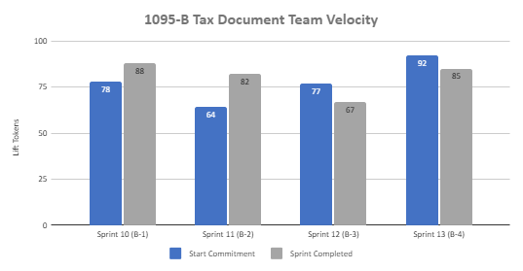
1095-B Sprint team velocity
 | Velocity details Velocity estimated in story points, using Fibonacci Velocity in Sprint 4 accounted for 10 team members 85 total story points were completed; Team committed to 92 story points at beginning of the sprint, 25 were blocked, and 18 additional story points added. 25 story point blocked due to Sitewide design changes (13), IRS form inaccessibility (4), legal (1), and no longer own (7); 18 story points were added with four stories brought forward due to new design capacity (15) and lift of 2 stories were higher than original estimate (3) All collaboration cycle events were not assigned story points * 8 story points are not accounted for in deliverables slides (24-26); VA platform onboarding (5), design tips / tricks (3)
03-22 Sprint 4 Demo
Appendix
33

Slide 34
Project risks and mitigation strategies
Submitted as part of the Monthly Report for March
RISK AND IMPACT | MITIGATION STRATEGY | DATE |  | STATUS | NOTES
 |  | ENTERED | CLOSED
IRS stakeholder is outside of VA ecosystem. Building without guidance or legal review regarding compliance with IRS regulation could result in risk. | Conduct research on available information surrounding current IRS 1095-B tax form regulations. Seek legal review through VA resources as directed by VA-PO and Business Owner | 1/20/22 | 2/11/22 |  | VA Business Owner clarified that IRS review is not needed
Team had previously confirmed with Business Owner that legal review was not needed. Business Owner clarified that legal review would be needed as of March 2nd | Business Owner is seeking a POC with the Office of General Counsel to understand what is needed and potential launch impact | 3/2/22 |  |  | Launch blocker
Data requires storage in a S3 bucket that the enrollment system can have access to in production; process to create the staging and production bucket does not have a clear timeline. Without the S3 bucket in prod with enrollment system access, product cannot be built in prod | Daily follow-ups with Jesse House and Mike Chelan (infrastructure team) | 3/1/22 |  |  | S3 bucket now in place. Risk resolved.
Business owner raised User Acceptance Testing should be done with HEC Call Center | Requested Business Owner to schedule UAT with required individuals for mid-March and book as early as possible | 3/2/22 |  |  | Aligned on UAT process; UAT on hold until build in staging approved by Collaboration Cycle
Feedback from Content and IA Review has taken over a week to come in; feedback is changing our proposal for the H1 and delaying confirmation of where the 1095-B landing page should live, which in turn delays our ability to complete the front end (top nav and side nav bars) | Design team pushing on IA team to confirm final answer of where 1095-B landing page should live and what the H1 header title should be | 03/04/22 | 3/8/22 |  | URL confirmed 3/7 EOD; IA review now closed
Designs were approved as part of Midpoint Review. Afterwards, Sitewide Content stated they would need to build our front end in Drupal and change our designs, impacting our in-flight build. | Design team met with Sitewide Content to align on redesigned front end. Tech working with Sitewide Content to send over our dynamic widget to be pulled into their static front end. Sitewide Content now owns the front end build. | 3/10/22 |  |  | Launch blocker
03-22 Sprint 4 Demo
Appendix
34

